Slide 1
CES2016.02: Gastric cancer
Mauricio Lema Medina MD
Notes:
1

Slide 2
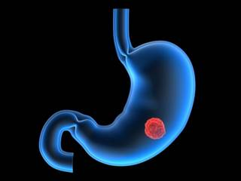
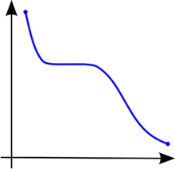
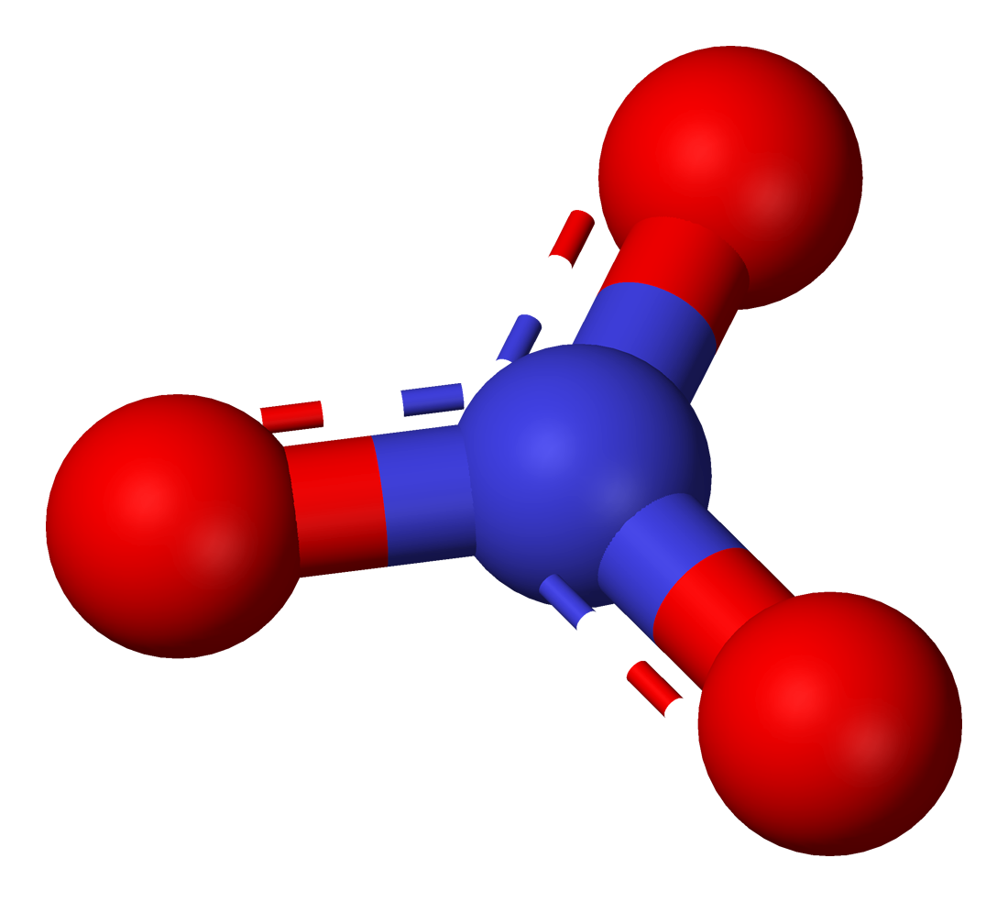
China
Japan
Ireland
Chile
Nitrates
Nurture
85% Adenocarcinomas
-Diffuse
-Intestinal type
15% Other tumors
-Lymphomas
-GIST
-Leiomyosarcomas
Nature

Slide 3
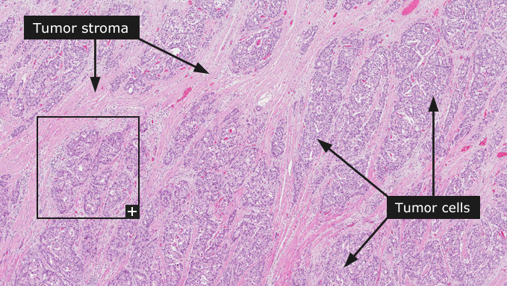
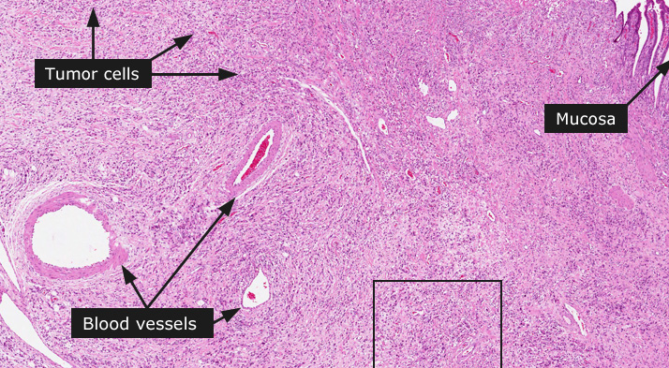
Poorly differentiated (diffuse)
Moderately differentiated (intestinal-type)
Gland-like structures
Ulcerative
Antrum and lesser curvature are the preferred sites
Long precancerous lesions
Association with H. pylori infection (non-proximal)
Marked geographic variability
Better prognosis
90% of adenocarcinomas (30%, 20%, 40% in distal-, mid- or proximal-stomach)
Her-2+ in 10-15% proximal tumors
Cell cohesion is absent (loss of E-cadherin),
Diffuse thickening of the stomach wall.
Linitis plastica.
Poor prognosis.
10% of stomach cancers
Appear in younger individuals
Same incidence all over the world
Not related to H. pylori infection.
http://www.proteinatlas.org/learn/dictionary/cancer/stomach+cancer+1

Slide 4
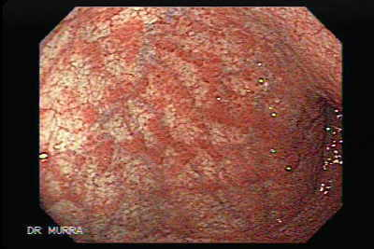
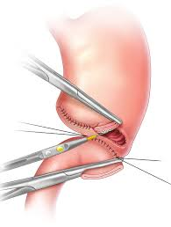
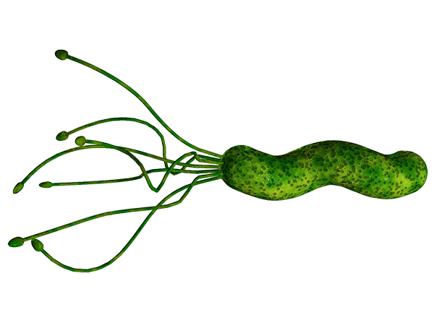
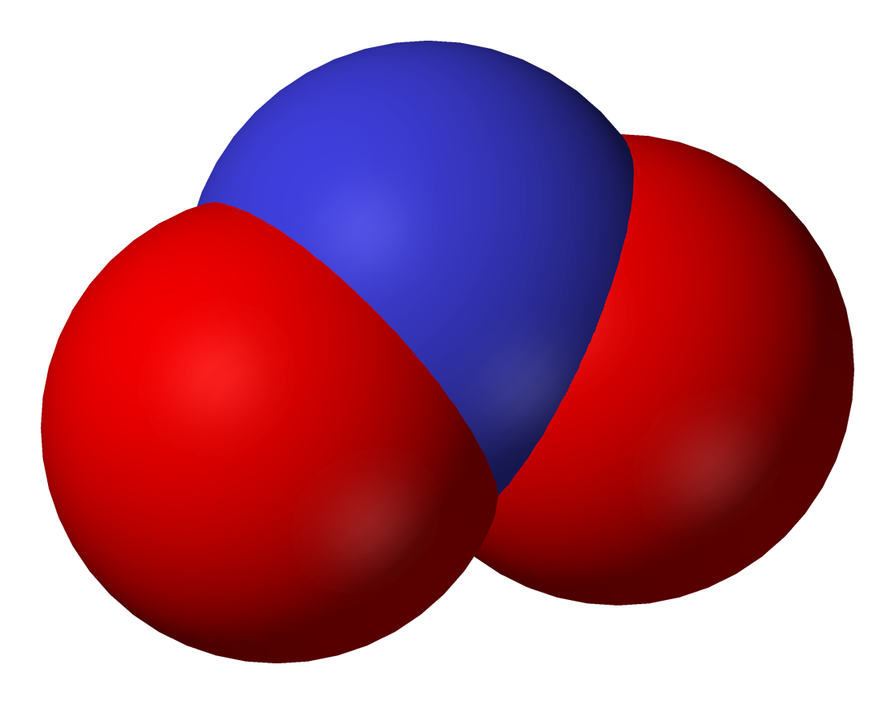
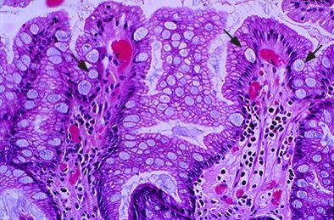
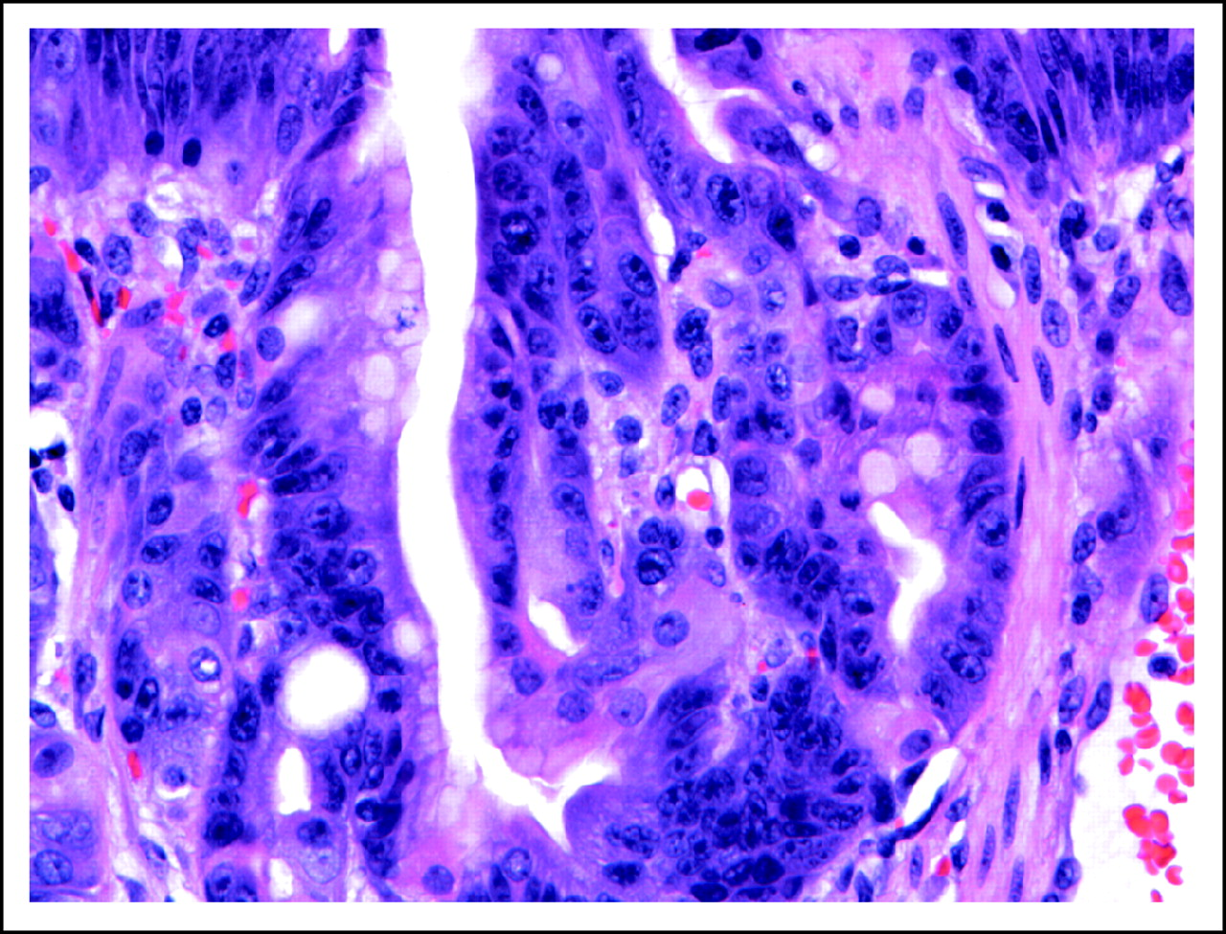
Atrophic gastritis/Pernicious anemia
Antrectomy
Better refrigeration
Acidity
Bacteria overgrowth
(from partially decayed food)
H. Pylori
Chronic inflammatory atrophic gastritis
Nitrates
Nitrites
Dried, smoked, salted food
Intestinal metaplasia
Gastric dysplasia
Intestinal-type adenocarcinoma
Other etiologic associations
Ménétrier’s disease
Blood group A
Germline mutation of E-Cadherin gene (CDH1) for familial diffuse gastric cancer
Unclear association: gastric ulcers, gastric polyps, antiacid therapy

Slide 5
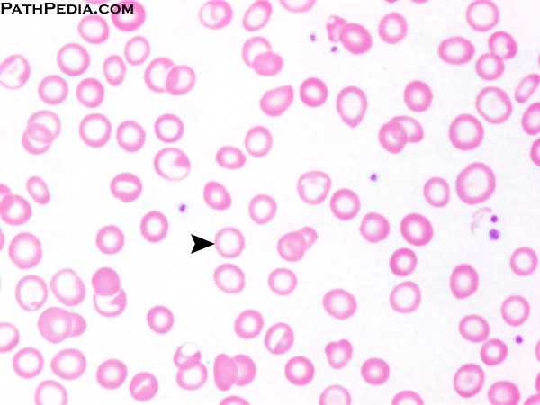
Upper abdominal dyscomfort
Anorexia
Iron-deficiency anemia
Nausea and vomiting
Weight loss
Dysphagia
Early satiety

Slide 6
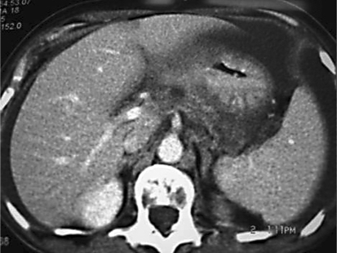
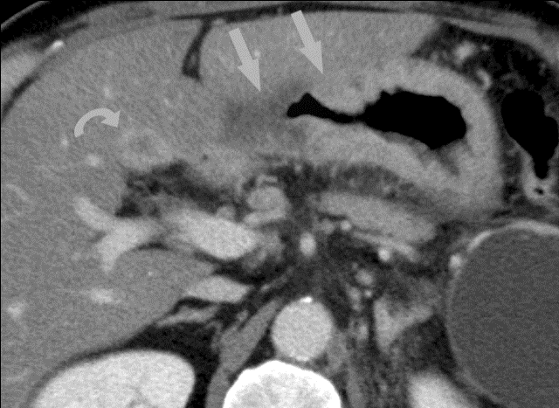
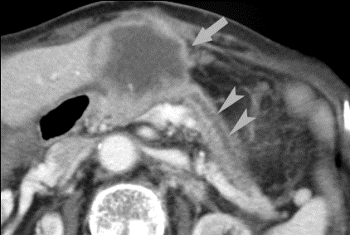
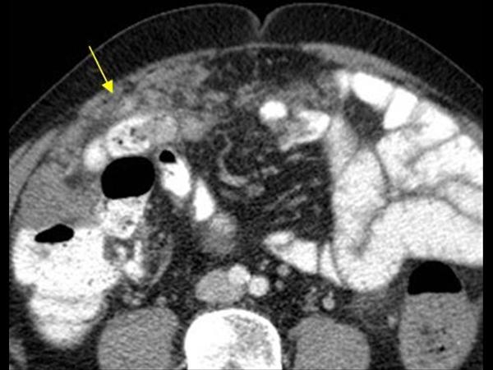
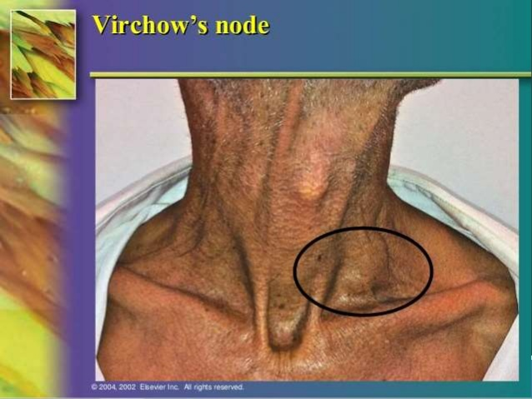
Direct extension to adjacent structures: liver, pancreas, colon, etc
Perigastric lymph nodes
Peritoneal carcinomatosis
Left supraclavicular metastasis
http://www.intechopen.com/books/gastric-carcinoma-new-insights-into-current-management/imaging-findings-of-gastric-carcinoma

Slide 7
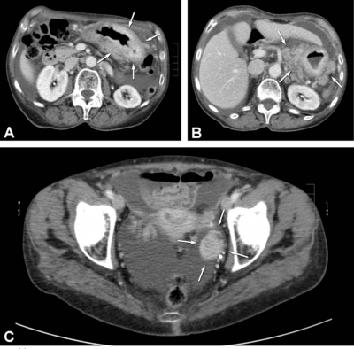
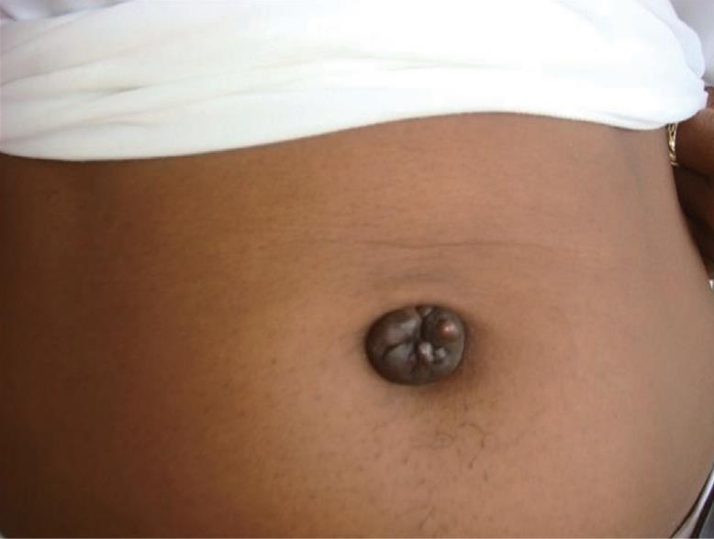
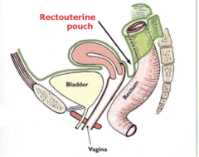
Abnormal gastric thickening
Regional lymph nodes / ascites
Krukenberg’s (metastasis to the ovaries)
Sister Mary Joseph node
Unusual clinical features associated with gastric adenocarcinomas
Migratory thrombophlebitis (Trousseau’s sign)
Microangiopathic hemolytic anemia
Diffuse seborrheic keratosis (Leser-Trélat sign)
Acanthosis nigricans
Blumer’s shelf

Slide 8
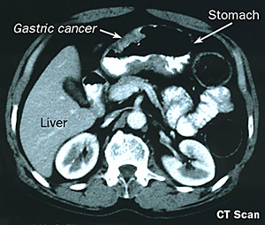
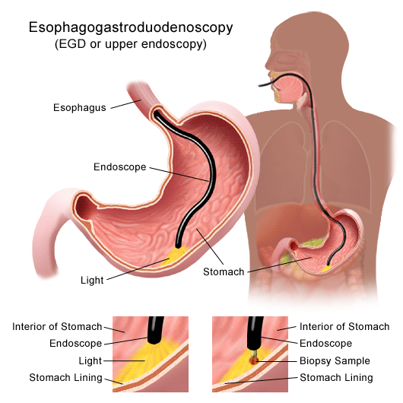
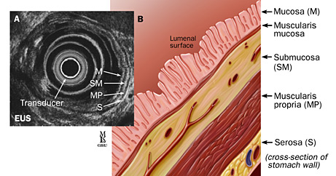
Endoscopic ultrasound (EUS)

Slide 9
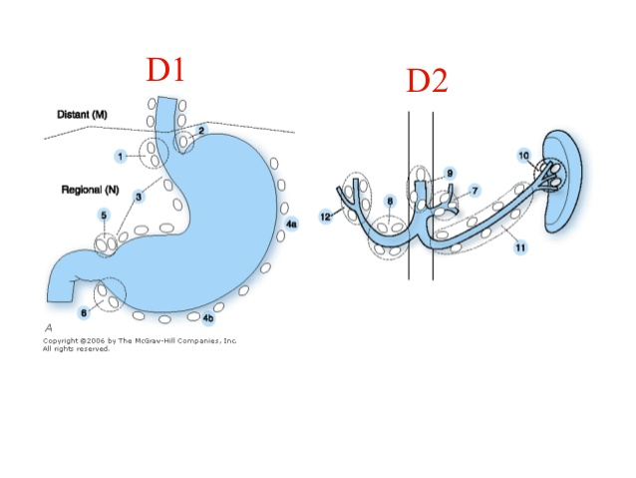
Number Description
1 Right paracardial
2 Left paracardial
3 Lesser curvature
a Along branches of left gastric artery
b Along 2nd branch and distal part of right gastric artery
4 Greater curvature
sa Along short gastric vessels
sb Along left gastroepiploic vessels
d Along 2nd branch and distal part of right gastroepiploic artery
5 Suprapyloric along 1st branch and proximal part of right gastric artery
6 Infrapyloric along 1st branch and proximal part of right gastroepiploic artery
7 Left gastric artery
8 Common hepatic artery
a Anterosuperior group
p Posterior group
9 Celiac artery
10 Splenic hilum
11 Along splenic artery
p Along proximal splenic artery
d Along distal splenic artery
12 Hepatoduodenal ligament
a Along proper hepatic artery
b Along bile duct
p Along portal vein
14 Along superior mesenteric vessels
v Along superior mesenteric vein
a Along superior mesenteric artery
D2 dissection
Extent of gastrectomy D1 dissection D2 dissection
Total gastrectomy 1–7 D1 + 8a, 9p, 11p, 11d, 12a
Distal/subtotal gastrectomy 1, 3, 4sb, 4d, 5, 6, 7 D1 + 8a, 9, 11p, 12a
Proximal gastrectomy 1,2,3a, 4sa, 4sb, 7 N/A

Slide 10
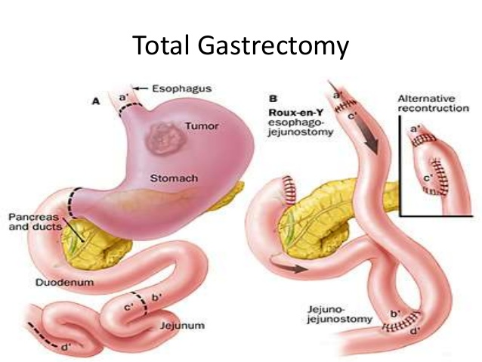
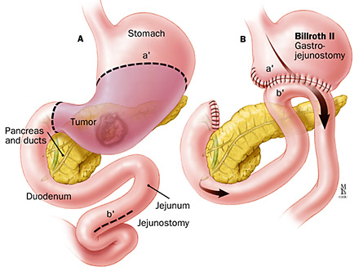
For proximal tumors
Subtotal gastrectomy: for distal tumors
D2 dissection

Slide 11
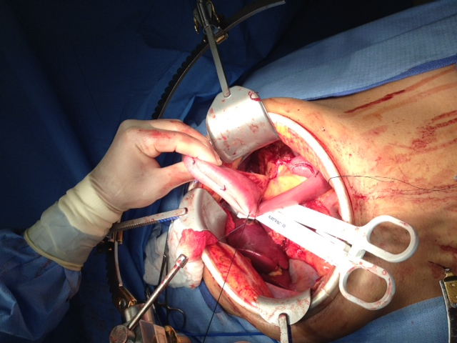
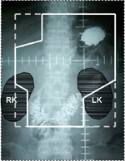
Preferred
MAGIC trial (Perioperative chemotherapy)
Chemo: ECX
CLASSIC (Postoperative chemotherapy)
Chemo: XELOX
Well-resected (D2)
Unclear quality of resection
INT 01-16: (Postoperative chemoradiation)
Chemo: FU + LV
Proximal (GEJ)
tumors
CROSS (Preoperative Chemoradiation)
Chemo: Carboplatin + Paclitaxel

Slide 12
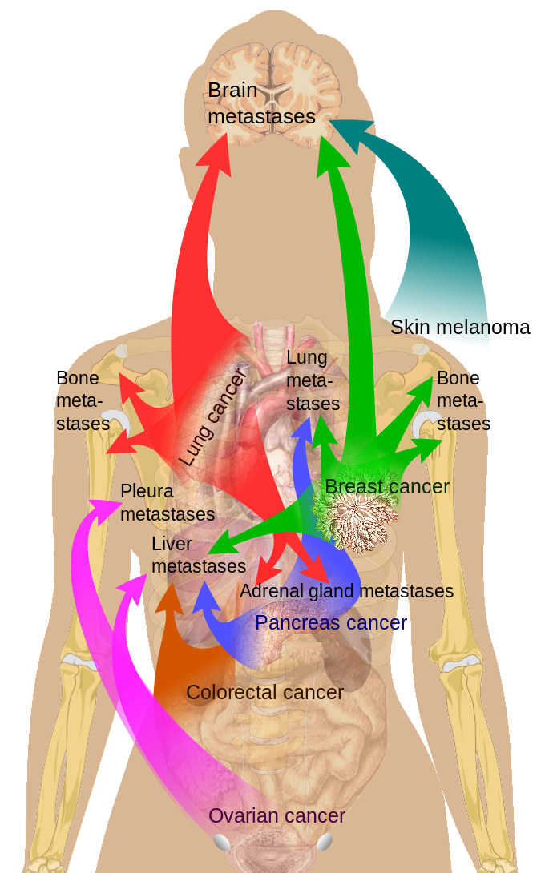
Dismal prognosis: median OS < 12 months (with chemotherapy)
Limited, short-lived response to chemotherapy
Cisplatin
Carboplatin
Fluououracil
Capecitabine
Docetaxel
Paclitaxel
Irinotecan
Ramucirumab (Anti VEGF R2 MOA)
Trastuzumab (Anti Her2 MOA) for Her2+ tumors
Most patients DO NOT derive benefit from palliative chemotherapy

Slide 13
5-year OS for distal tumors after complete resection: 20%
5-year OS for proximal tumors after complete resection: 10%
5-year survival by Stage
Stage 0: 99%
Stage IA: 59%
Stage IB: 44%
Stage II: 29%
Stage IIIA: 15%
Stage IIIB: 9%
Stage IIIC: N/A
Stage IV: 3%
Median OS in metastatic disease: < 12months

